Slide 1
Market Research
Andrew Cooper
1704746
Software Engineering
Notes:
Deloitte
BCG
PwC

Slide 2
Assistive Technology
What is assistive technology?
Notes:
This is technology that can be implemented in a device or service which could assist users in tasks that could be challenging or impossible. REF<- https://www.washington.edu/accessit/print.html?ID=1109

Slide 3
Target Market
We aim to provide an application for people with hearing impairment.
Target consumer: People with hearing difficulties from the ages of 13 and above.
Notes:
* Our aim is to make the application easily accessible for users.

Slide 4
Is there a market?
Over 5% of the world’s population suffer from hearing loss.
By 2050 estimated 900 million people
“Despite representing a significant cross section of British consumers, blind and deaf people consistently fail to show up on the radars of the UK’s biggest brands ”.
1
1
Notes:
**2050 ← 1 in 10
***https://www.marketingweek.com/2017/10/31/marketing-to-deaf-and-blind-consumers/

Slide 5
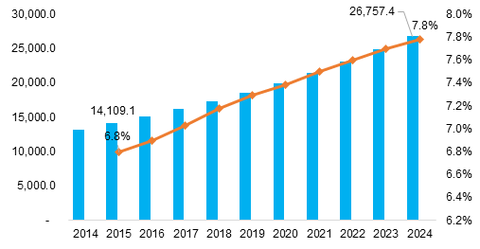
Notes:
Assistive technology market revenue: Increase in market revenue as years increase. In millions.

Slide 6
Notes:
Assistive Technology - Market and Research, Prof. Dr.-Ing .Christian Bühler

Slide 7
Competition
RogerSpeaks
Unitact
Functionality and improved features
Notes:
Other apps only cover specific things
Unitact ← 31,768 euros earned on kickstarter. 30,000 ← goal

Slide 8
https://www.reuters.com/brandfeatures/venture-capital/article?id=11672 ← 2017 – 2023 hearing aid devices increase 5.1%

Slide 9
Statistics

Slide 10
Reference List
https://smallbusiness.chron.com/insert-reference-powerpoint-2007-53799.html

